Slide 1
Statistical Learning

Slide 2
Feature Extraction
Feature extraction is a machine learning and data analysis process that transforms raw data into numerical features.
Feature extraction refers to the process of transforming raw data into numerical features that can be processed while preserving the information in the original data set.
Feature extraction is a process used in machine learning to reduce the number of resources needed for processing without losing important or relevant information.

Slide 3
Why is Feature Extraction Important?
Reduction of Computational Cost: By reducing the dimensionality of the data, machine learning algorithms can run more quickly.
Improved Performance: Algorithms often perform better with a reduced number of features. This is because noise and irrelevant details are removed, allowing the algorithm to focus on the most important aspects of the data.
Prevention of Overfitting: With too many features, models can become overfitted to the training data, meaning they may not generalize well to new, unseen data. Feature extraction helps to prevent this by simplifying the model.
Better Understanding of Data: Extracting and selecting important features can provide insights into the underlying processes that generated the data.

Slide 4
Principal Component Analysis
Principal Component Analysis is an unsupervised learning algorithm that is used for the dimensionality(or features) reduction in machine learning.
Dimensionality reduction in machine learning refers to the process of reducing the number of random variables (or features) under consideration.
This reduction can be achieved by obtaining a set of principal variables.
Dimensionality reduction can be used for feature selection, feature extraction, or a combination of the two.

Slide 5
Principal Component Analysis (PCA) is an unsupervised learning algorithm technique used to examine the interrelations among a set of variables. It is also known as a general factor analysis

Slide 6
Principal Component Analysis
Principal Component Analysis (PCA) is a statistical procedure that uses an orthogonal transformation that converts a set of correlated variables to a set of uncorrelated variables.
Set of Correlated Variables: PCA is typically applied to a dataset containing multiple correlated variables (features). The goal of PCA is to find a new set of variables (principal components) that are linear combinations of the original variables but are uncorrelated with each other.

Slide 7
Uncorrelated Variables: The principal components derived from PCA are uncorrelated, which means that the covariance between any pair of principal components is zero.

Slide 8
The PCA algorithm is based on some mathematical concepts such as:
Variance and Covariance
Eigenvalues and Eigen vectors

Slide 9
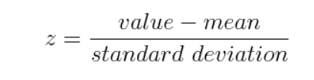
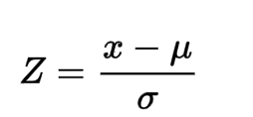
STEP 1: Standardization

Slide 10
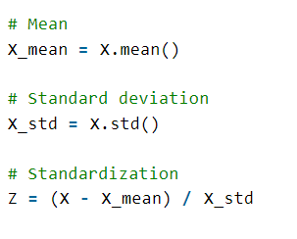

Slide 11
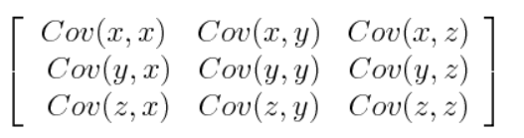
STEP 2: Covariance Matrix Computation

Slide 12
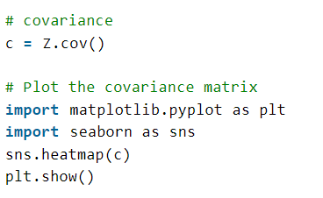

Slide 13
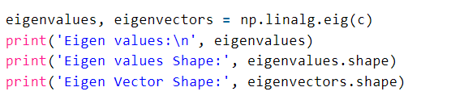
Step 3: Compute Eigenvalues and Eigenvectors of Covariance Matrix to Identify Principal Components

Slide 14
Singular Value Decomposition(SVD)
The singular value decomposition(SVD) of a matrix is a factorization of that matrix into three matrices.
Singular-value decomposition is also one of the popular dimensionality reduction techniques.
It is the matrix-factorization method of linear algebra, and it is widely used in different applications such as feature selection, visualization, noise reduction, and many more.

Slide 15
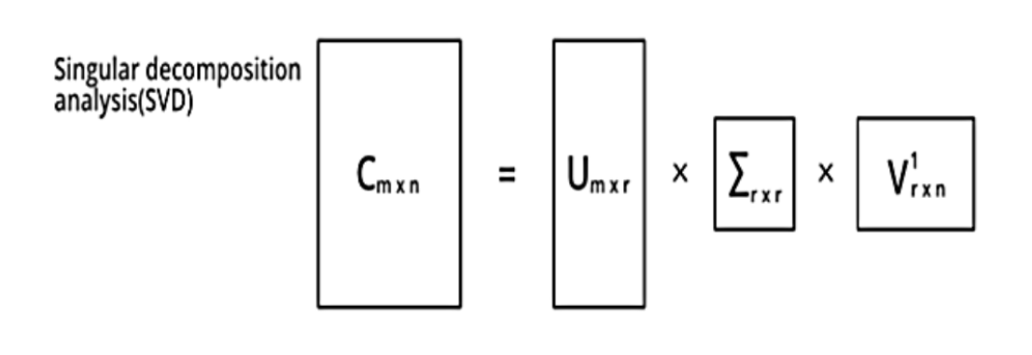

Slide 16
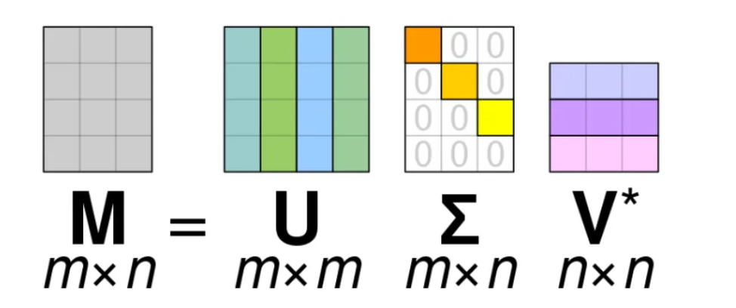

Slide 17
Intensity Level of the image(Which is applicable in Discrete signal)
Since an image is contiguous, the values of most pixels depend on the pixels around them.

Slide 18
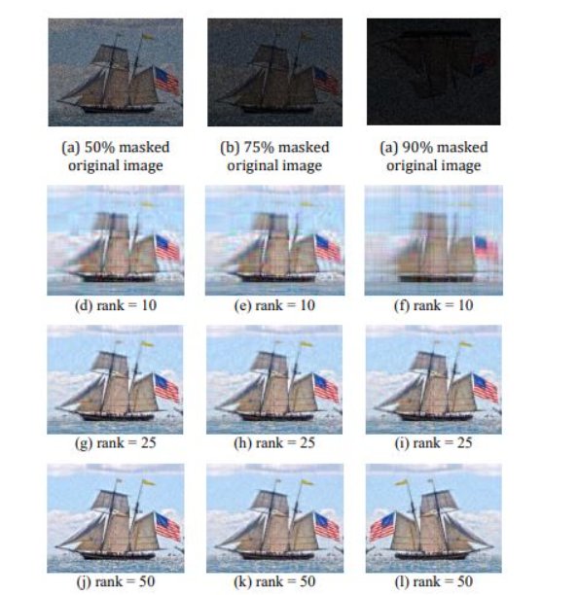

Slide 19
Application of SVD
Image Recovery
Image Compression

Slide 20
Feature Selection
While developing the machine learning model, only a few variables in the dataset are useful for building the model, and the rest features are either redundant or irrelevant.
If we input the dataset with all these redundant and irrelevant features, it may negatively impact and reduce the overall performance and accuracy of the model.
A feature is an attribute that has an impact on a problem or is useful for the problem, and choosing the important features for the model is known as feature selection.

Slide 21
The main difference between them is that feature selection is about selecting the subset of the original feature set, whereas feature extraction creates new features.
Feature selection is a way of reducing the input variable for the model by using only relevant data to reduce overfitting in the model.
It is a process of automatically or manually selecting the subset of most appropriate and relevant features to be used in model building.

Slide 22
Need for Feature Selection
Before implementing any technique, it is really important to understand, need for the technique and so for the Feature Selection. As we know, in machine learning, it is necessary to provide a pre-processed and good input dataset in order to get better outcomes.
We collect a huge amount of data to train our model and help it to learn better. Generally, the dataset consists of noisy data, irrelevant data, and some part of useful data. Moreover, the huge amount of data also slows down the training process of the model, and with noise and irrelevant data, the model may not predict and perform well.

Slide 23
Benefits of using feature selection in machine learning:
It helps in avoiding the curse of dimensionality.
It helps in the simplification of the model so that it can be easily interpreted by the researchers.
It reduces the training time.
It reduces overfitting hence enhance the generalization.

Slide 24

Feature Selection Techniques

Slide 25
Wrapper Method
In wrapper methods, different subsets of features are evaluated by training a model for each subset, and then the performance is compared and the right combination is chosen.

Slide 26
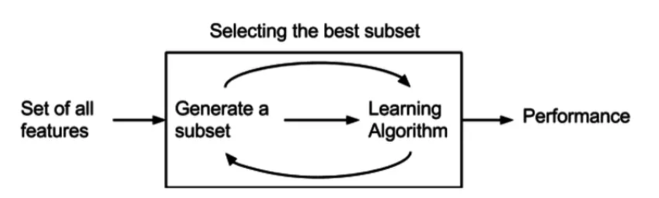

Slide 27
Some techniques of wrapper methods:
Forward selection
Backward elimination
Exhaustive Feature Selection
Recursive Feature Elimination

Slide 28
Forward Selection
Starting from Scratch: Begin with an empty set of features and iteratively add one feature at a time.
Model Evaluation: At each step, train and evaluate the machine learning model using the selected features.
Stopping Criterion: Continue until a predefined stopping criterion is met, such as a maximum number of features or a significant drop in performance.
Notes:
https://arismuhandisin.medium.com/understanding-wrapper-methods-in-machine-learning-a-guide-to-feature-selection-23f71059abf8

Slide 29
Backward Elimination
Starting with Everything: Start with all available features.
Iterative Removal: In each iteration, remove the least important feature and evaluate the model.
Stopping Criterion: Continue until a stopping condition is met.

Slide 30
Exhaustive Search
Exploring All Possibilities: Evaluate all possible combinations of features, which ensures finding the best subset for model performance.
Computational Cost: This can be computationally expensive, especially with a large number of features.

Slide 31
Recursive Feature Elimination (RFE)
Ranking Features: Start with all features and rank them based on their importance or contribution to the model.
Iterative Removal: In each iteration, remove the least important feature(s).
Stopping Criterion: Continue until a desired number of features is reached.

Slide 32
Filter Method
These methods are generally used while doing the pre-processing step. These methods select features from the dataset irrespective of the use of any machine learning algorithm.
In terms of computation, they are very fast and inexpensive and are very good for removing duplicated, correlated, redundant features but these methods do not remove multicollinearity.

Slide 34
Techniques
Information Gain
Chi-square test
Fisher’s Score
Correlation Coefficient

Slide 35
Information Gain
It is defined as the amount of information provided by the feature for identifying the target value and measures reduction in the entropy values. Information gain of each attribute is calculated considering the target values for feature selection.
In the context of information theory and machine learning, entropy is a measure of uncertainty or randomness associated with a random variable.

Slide 36

Chi-square test
Chi-square method (X2) is generally used to test the relationship between categorical variables. It compares the observed values from different attributes of the dataset to its expected value.

Slide 37
Fisher’s Score
Fisher’s Score selects each feature independently according to their scores under Fisher criterion leading to a suboptimal set of features. The larger the Fisher’s score is, the better is the selected feature.

Slide 38
Correlation Coefficient
Pearson’s Correlation Coefficient is a measure of quantifying the association between the two continuous variables and the direction of the relationship with its values ranging from -1 to 1.

Slide 39
Embedded Method
Embedded methods combine the advantageous aspects of both Filter and Wrapper methods.
Embedded methods combined the advantages of both filter and wrapper methods by considering the interaction of features along with low computational cost.
These are fast processing methods similar to the filter method but more accurate than the filter method.

Slide 40
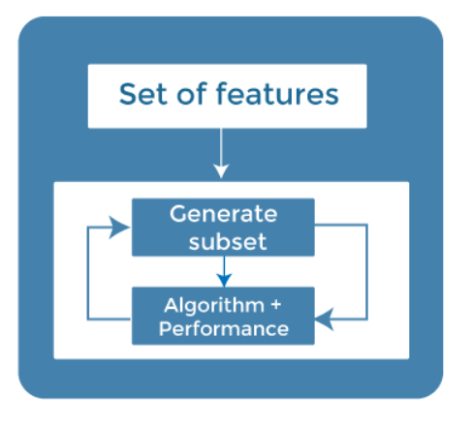

Slide 41
These methods are also iterative, which evaluates each iteration, and optimally finds the most important features that contribute the most to training in a particular iteration. :

Slide 42
Some techniques of embedded methods
Regularization
Random Forest Importance
Notes:
In machine learning, overfitting occurs when a model learns the training data too well, including its noise and outliers, resulting in poor performance on unseen data.

Slide 43
Regularization
Regularization adds a penalty term to different parameters of the machine learning model to avoid overfitting in the model.
This penalty term is added to the coefficients; hence it shrinks some coefficients to zero. Those features with zero coefficients can be removed from the dataset.
The types of regularization techniques are L1 Regularization (Lasso Regularization) or d L2 regularization(Ridge Regularization)

Slide 44
Random Forest Importance
Different tree-based methods of feature selection help us with feature importance to provide a way of selecting features. Here, feature importance specifies which feature has more importance in model building or has a great impact on the target variable.
Random Forest is a tree-based method, which is a type of bagging algorithm that aggregates a different number of decision trees.

Slide 45
Evaluating ML Algo and Model Selection
Model evaluation is the process that uses some metrics that help us to analyze the performance of the model.

Slide 46
Accuracy
Accuracy: Accuracy is defined as the ratio of the number of correct predictions to the total number of predictions.
accuracy_score

Slide 47

Precision
Precision is the ratio of true positives to the summation of true positives and false positives. It basically analyses the positive predictions.
The drawback of Precision is that it does not consider the True Negatives and False Negatives.
precision_score()

Slide 48

Recall
Recall is the ratio of true positives to the summation of true positives and false negatives. It basically analyses the number of correct positive samples.
recall_score()

Slide 49
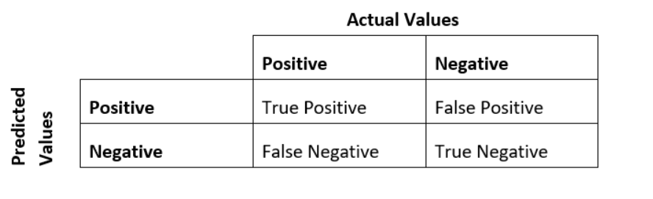
Confusion Matrix
The confusion matrix is a representation of the accuracy of the classification model.

Slide 50
True Positive: - This is the number of times the model predicted an independent variable as positive when the actual value was positive.
False Positive: - This is the number of times the model predicted an independent variable as positive when the actual value was negative.
False Negative: - This is the number of times the model predicted an independent variable as negative when the actual value was positive.
True Negative: - This is the number of times the model predicted an independent variable as negative when the actual value was negative.

